Slide 1
Unit 1 Quantities & Units
Part D: Metric Prefixes

Slide 2
What will you learn?
Use metric prefixes to represent exponent values in scientific and engineering notations.
Convert from one metric prefix to another.

Slide 3
Metric Prefix, centi (c)
The length 0.0538 m can be expressed in
scientific notation as: 5.38 × 10⁻² m
The exponential term, 10⁻², can be replaced by “centi” (symbol “c”).
Hence the length 0.0538 m = 5.38 cm.
This makes reading and understanding of the figure simple.
The letter “c” is a metric prefix.

Slide 4
Metric Prefix, milli (m)
The length 0.0538 m can be expressed in
engineering notation as: 53.8 × 10⁻³ m
The exponential term, 10⁻³, can be replaced by “milli” (symbol “m”).
Hence the length 0.0538 m = 53.8 mm.
This makes reading and understanding of the figure simple.
“m” is an other metric prefix.

Slide 5
Prefix | Symbol | Exponential | Multiplier
tera | T | 10¹² | 1000000000000
giga | G | 10⁹ | 1000000000
mega | M | 10⁶ | 1000000
kilo | k | 10³ | 1000
hecto | h | 10² | 100
deca | da | 10¹ | 10
deci | d | 10⁻¹ | 0.1
centi | c | 10⁻² | 0.01
milli | m | 10⁻³ | 0.001
micro | µ | 10⁻⁶ | 0.000001
nano | n | 10⁻⁹ | 0.000000001
pico | p | 10⁻¹² | 0.000000000001
Table of metric prefixes

Slide 6
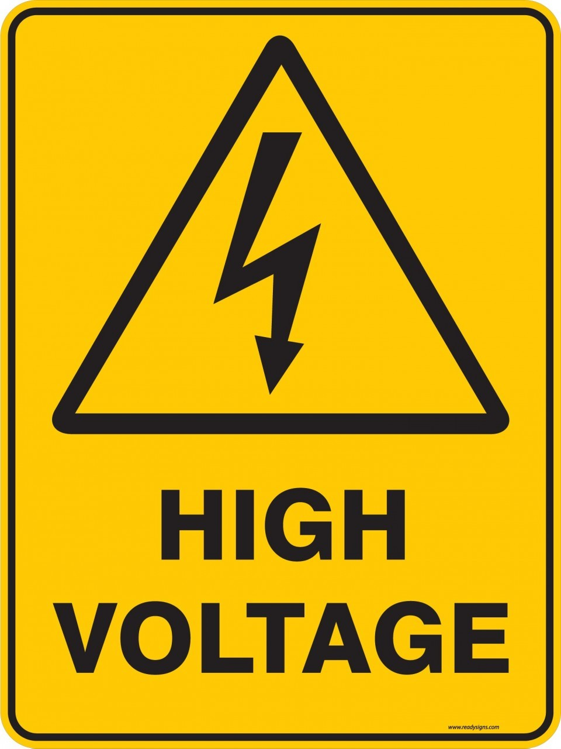
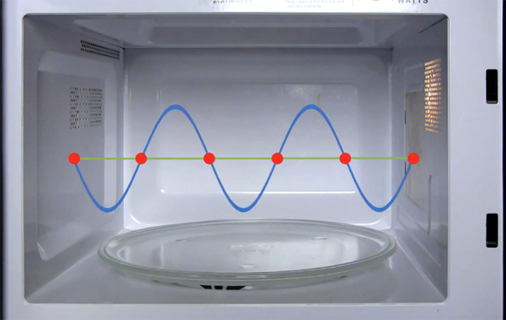

Represent large and small numbers with metric prefixes
High voltage power lines
400,000 V = 400 × 10³ V
= 400 kV
Microwave frequency of a microwave oven
25,000,000,000,000 Hz = 25 × 10¹² Hz
= 25 THz
A current in a smart phone circuit
0.0000000812 A = 81.2 × 10⁻⁹ A
= 81.2 nA
Smart phone

Slide 7
Convert the length 220 cm to millimetres.
∵ 1 cm = 10⁻² m
1 mm = 10⁻³ m
cm mm
× 10
∴ 1 cm = 10 mm
∴ 220 cm = 2200 mm

Slide 8
Convert the voltage 30,000 kV to megavolts.
∵ 1 kV = 10³ V
kV MV
1 MV = 10⁶ V
÷ 1000
∴ 1 kV = 10⁻³ MV
∴ 30,000 kV = 30,000 × 10 ⁻³ MV
= 30 MV

Slide 9
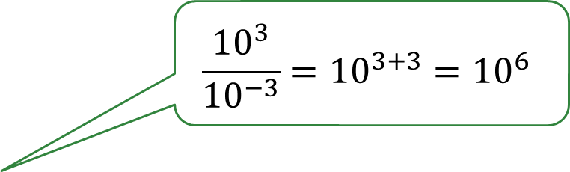
Convert the current 0.0035 kA to milliamperes.
∵ 1 kA = 10³ A
$$\frac{{10}^{3}}{{10}^{−3}}={10}^{3+3}={10}^{6}$$
1 mA = 10⁻³ A
∴ 1 kA = 10⁶ mA
∴ 0.0035 kA = 0.0035 × 10⁶ mA
= 3500 mA

Slide 10
What you have learned?
Represent numbers in metric prefixes.
Convert from one metric prefix to another.
Metric prefixes are commonly used, such as TV channels (MHz in VHF, GHz in UHF), memory size (Mb, Gb), vehicle velocity (km/hr), and etc.

Slide 11
Coming Up Next
Unit 2: Electric Charge, Voltage and Current

